Slide 1
More HTML, Accessible Design, and CSS Preview
Lecture 2

Slide 2
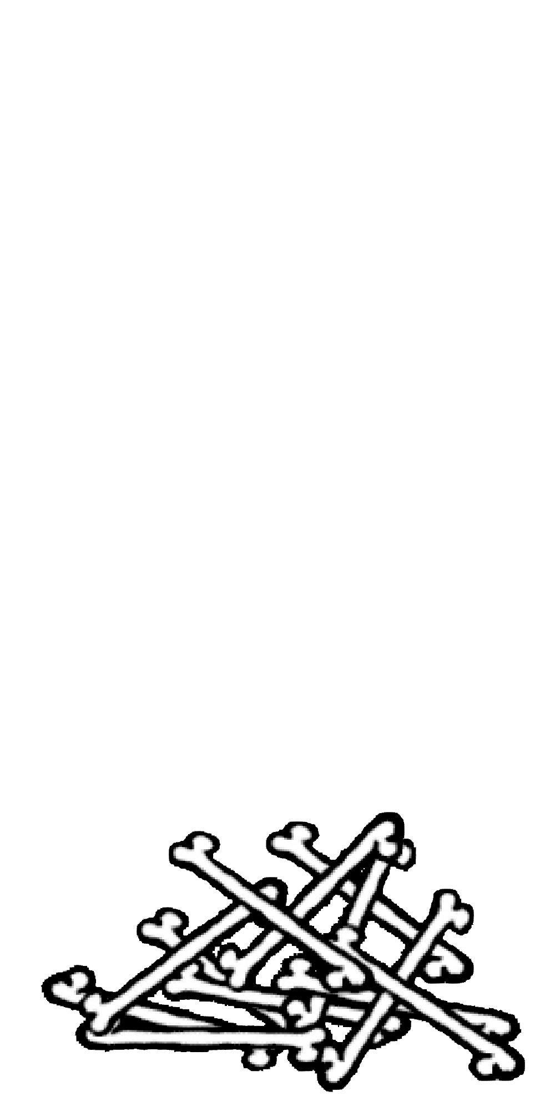
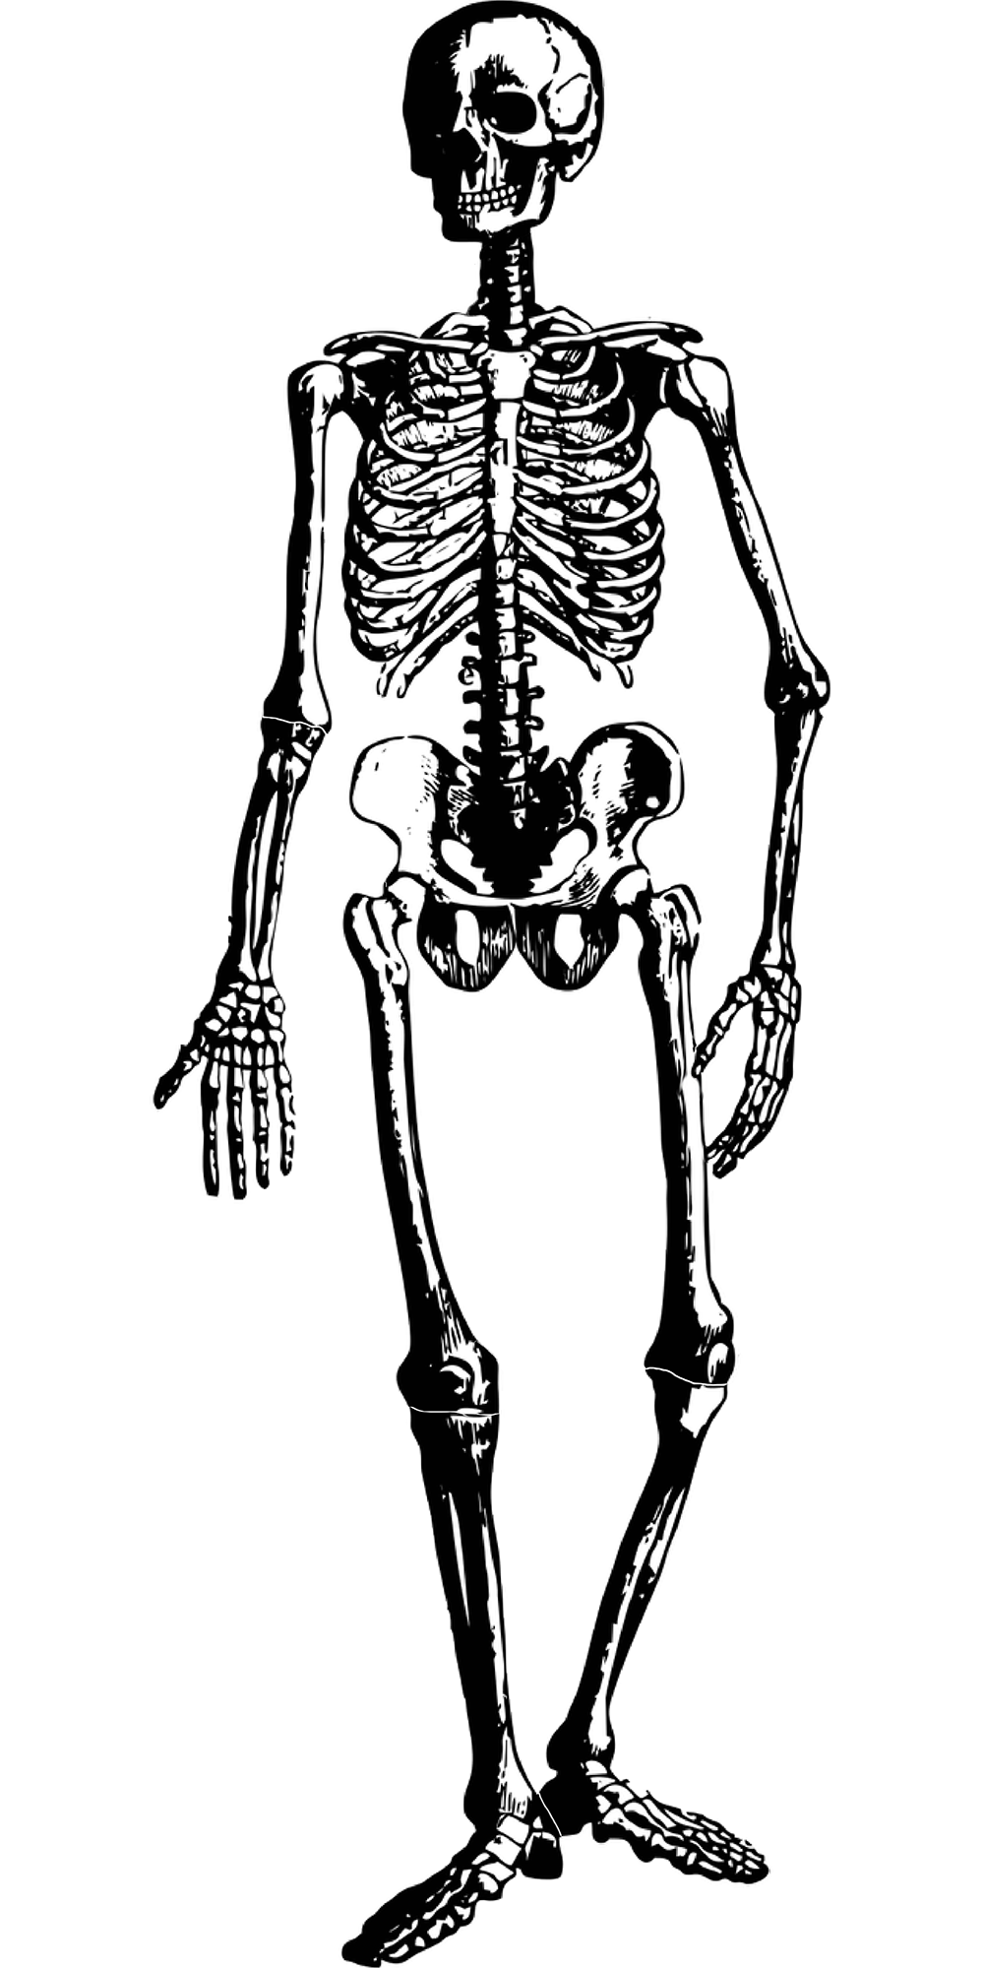
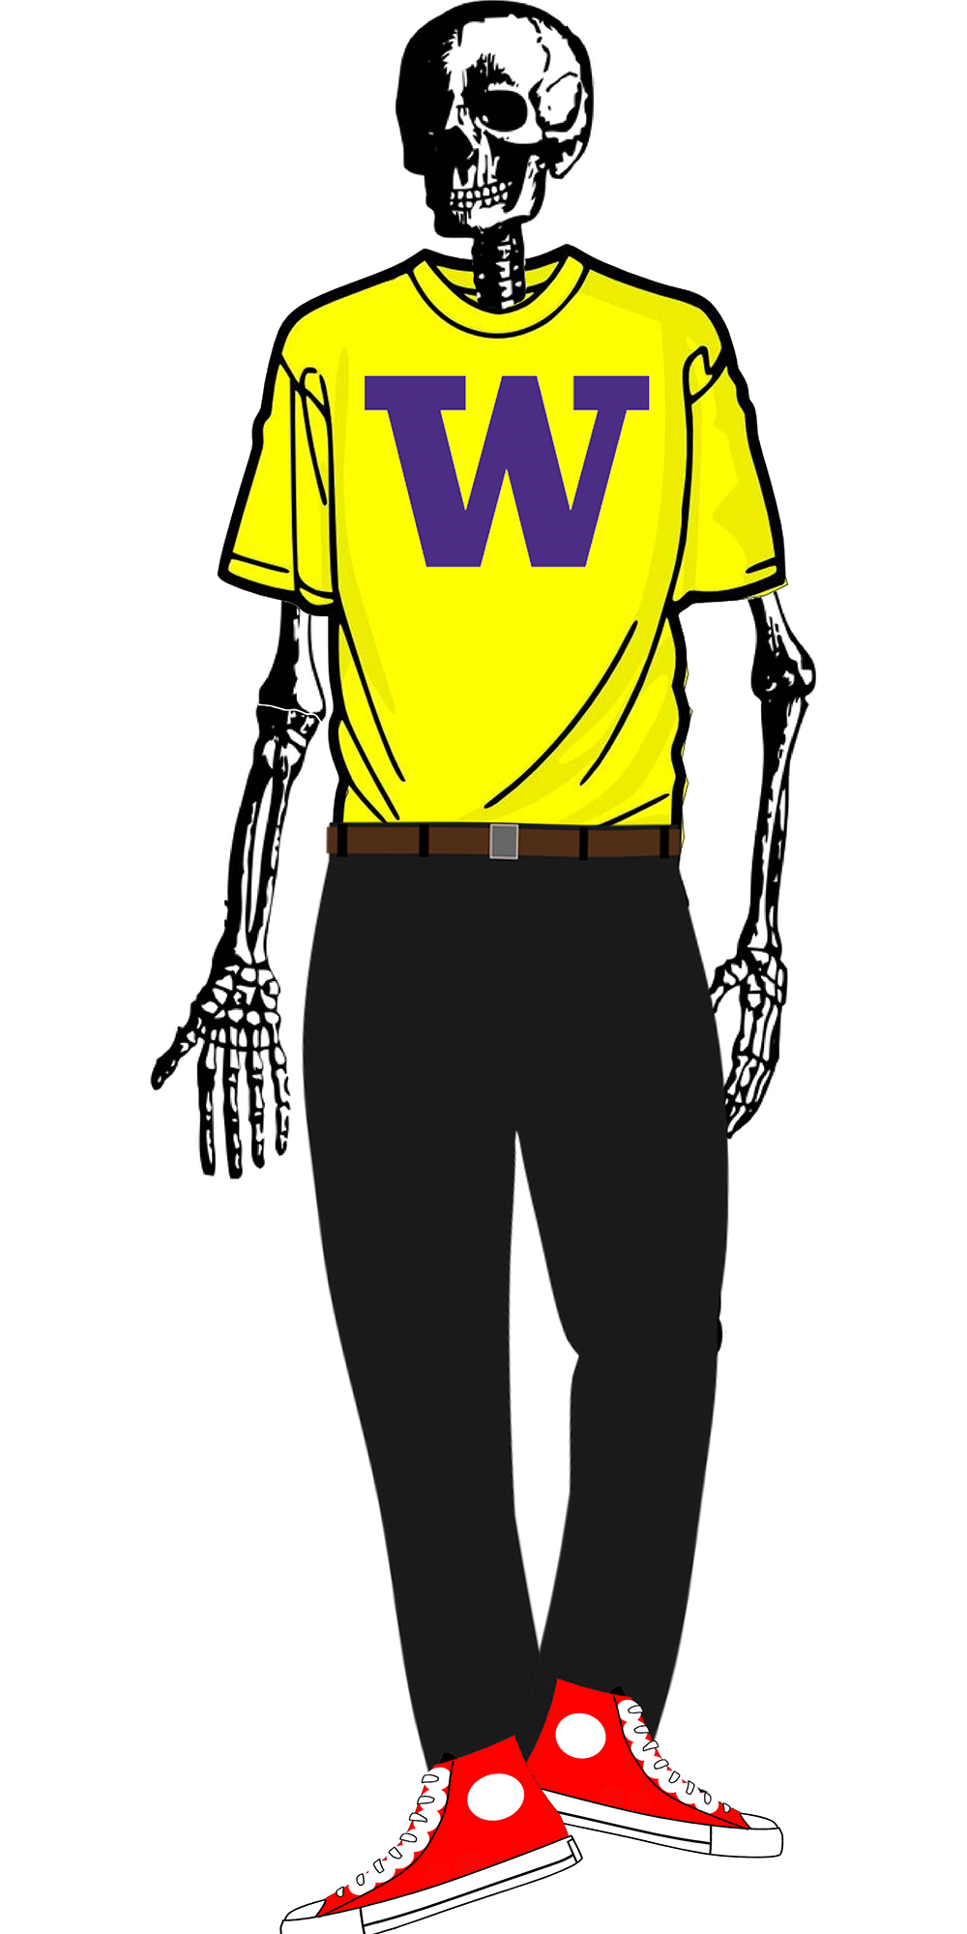
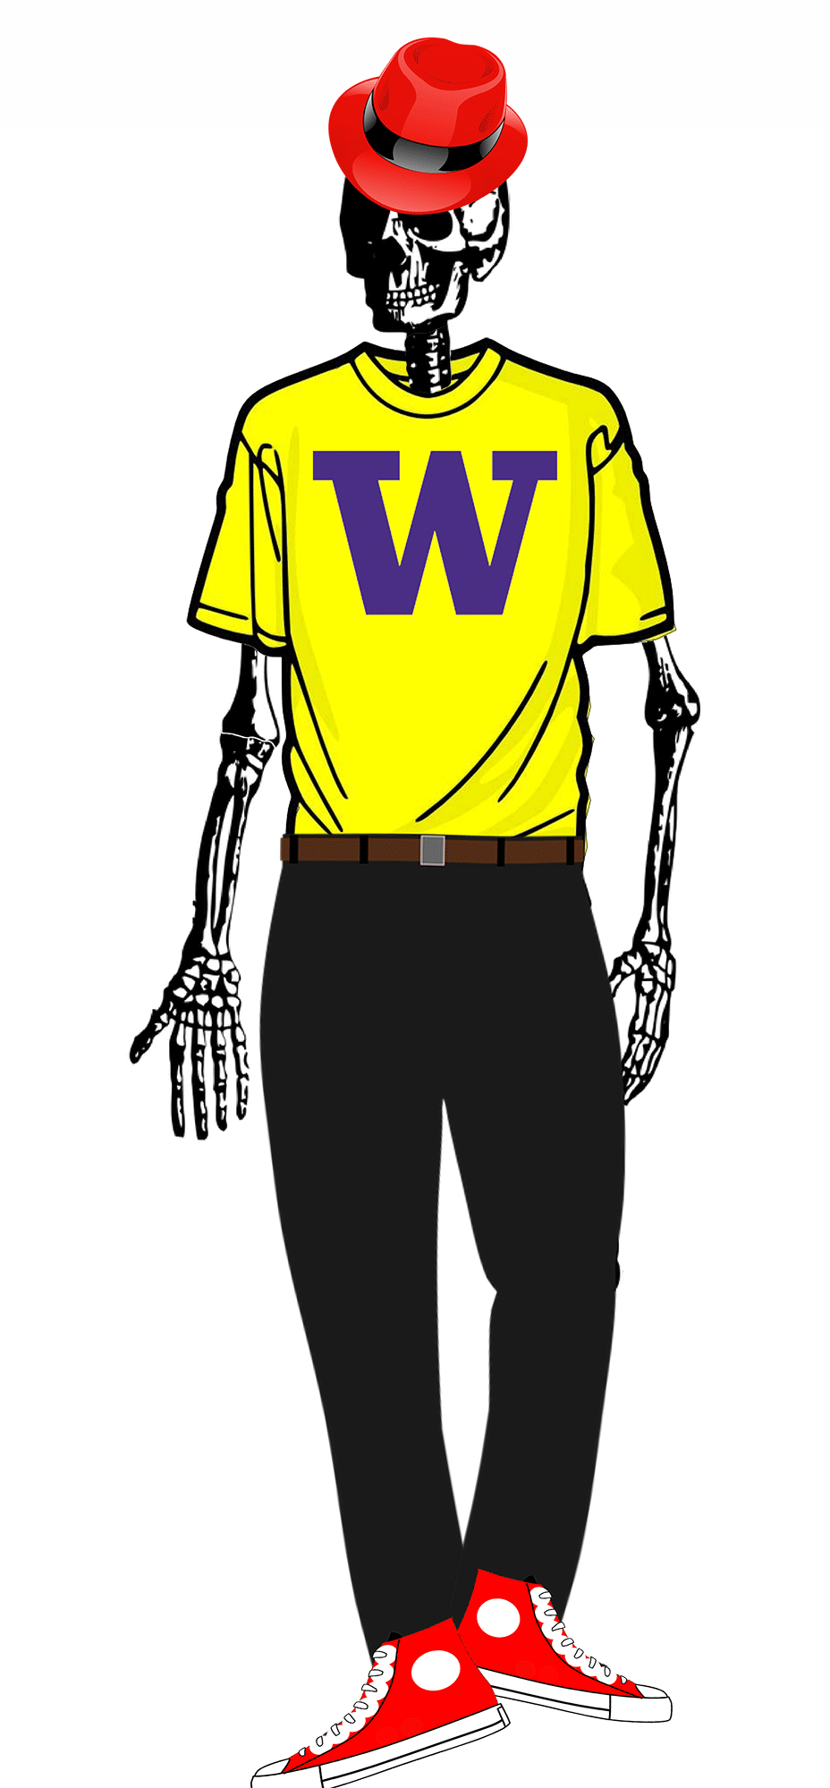
Review: Websites
WORDS + IMAGES
HTML
CSS
JAVASCRIPT

Slide 3
Ok, but really… Web? Internet? The same, right?
Nope! An analogy...
🏠

Slide 4
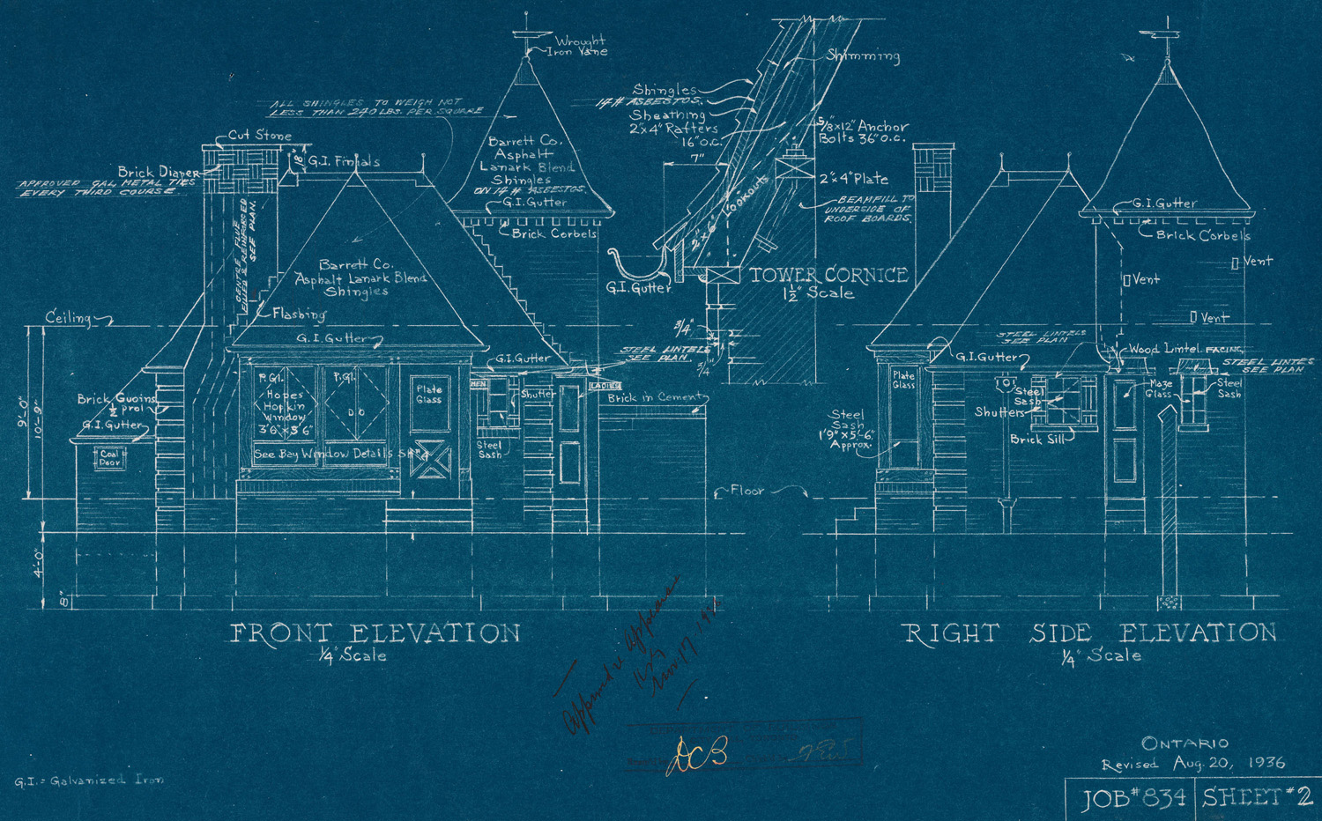
Where does the house come from?
© City of Toronto public archives

Slide 5
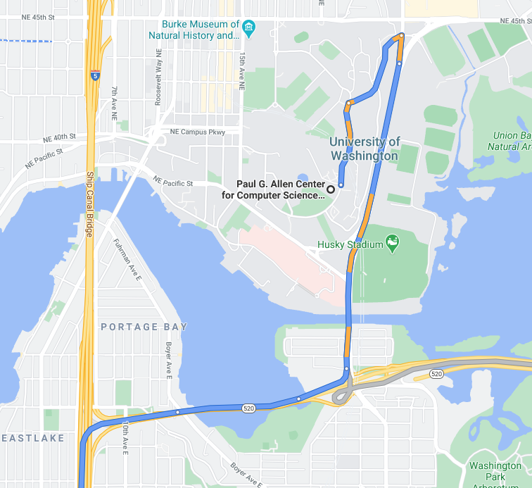
Getting to the House
Usually:
Get the address
Ask someone for directions from your address to the House's address
Series of instructions:
Turn here, follow until there
Continue until you reach this
Look for House
Follow directions

Slide 6
In this analogy...
The Internet is kind of like:
The roads you take to get from one place to another
Plus the related tools to make using those roads possible (cars, signs, traffic control, GPS, etc.)
The Web is kind of like:
References to houses or businesses, and the things you see inside of them.
"If you want to talk to Alex, you can find them at 123 Street Way."

Slide 7
Refining the analogy
We'd never do this for real houses, but the web is more like:
Go to the house's address
Ask whoever answers for the current blueprints to the house
Go back to your own home/residence
Build the thing the blueprints represent
(Might need to go back to the other house to pick up some speciality supplies.)
After you're done looking at or using it, throw it away.

Slide 8
HTML
Like "blueprints" throughout the internet.

Slide 9
Tips when drafting HTML/CSS web pages
Always start with a sketch/wireframe before jumping into code!
A great resource on getting started with wireframes can be found here.

Slide 10
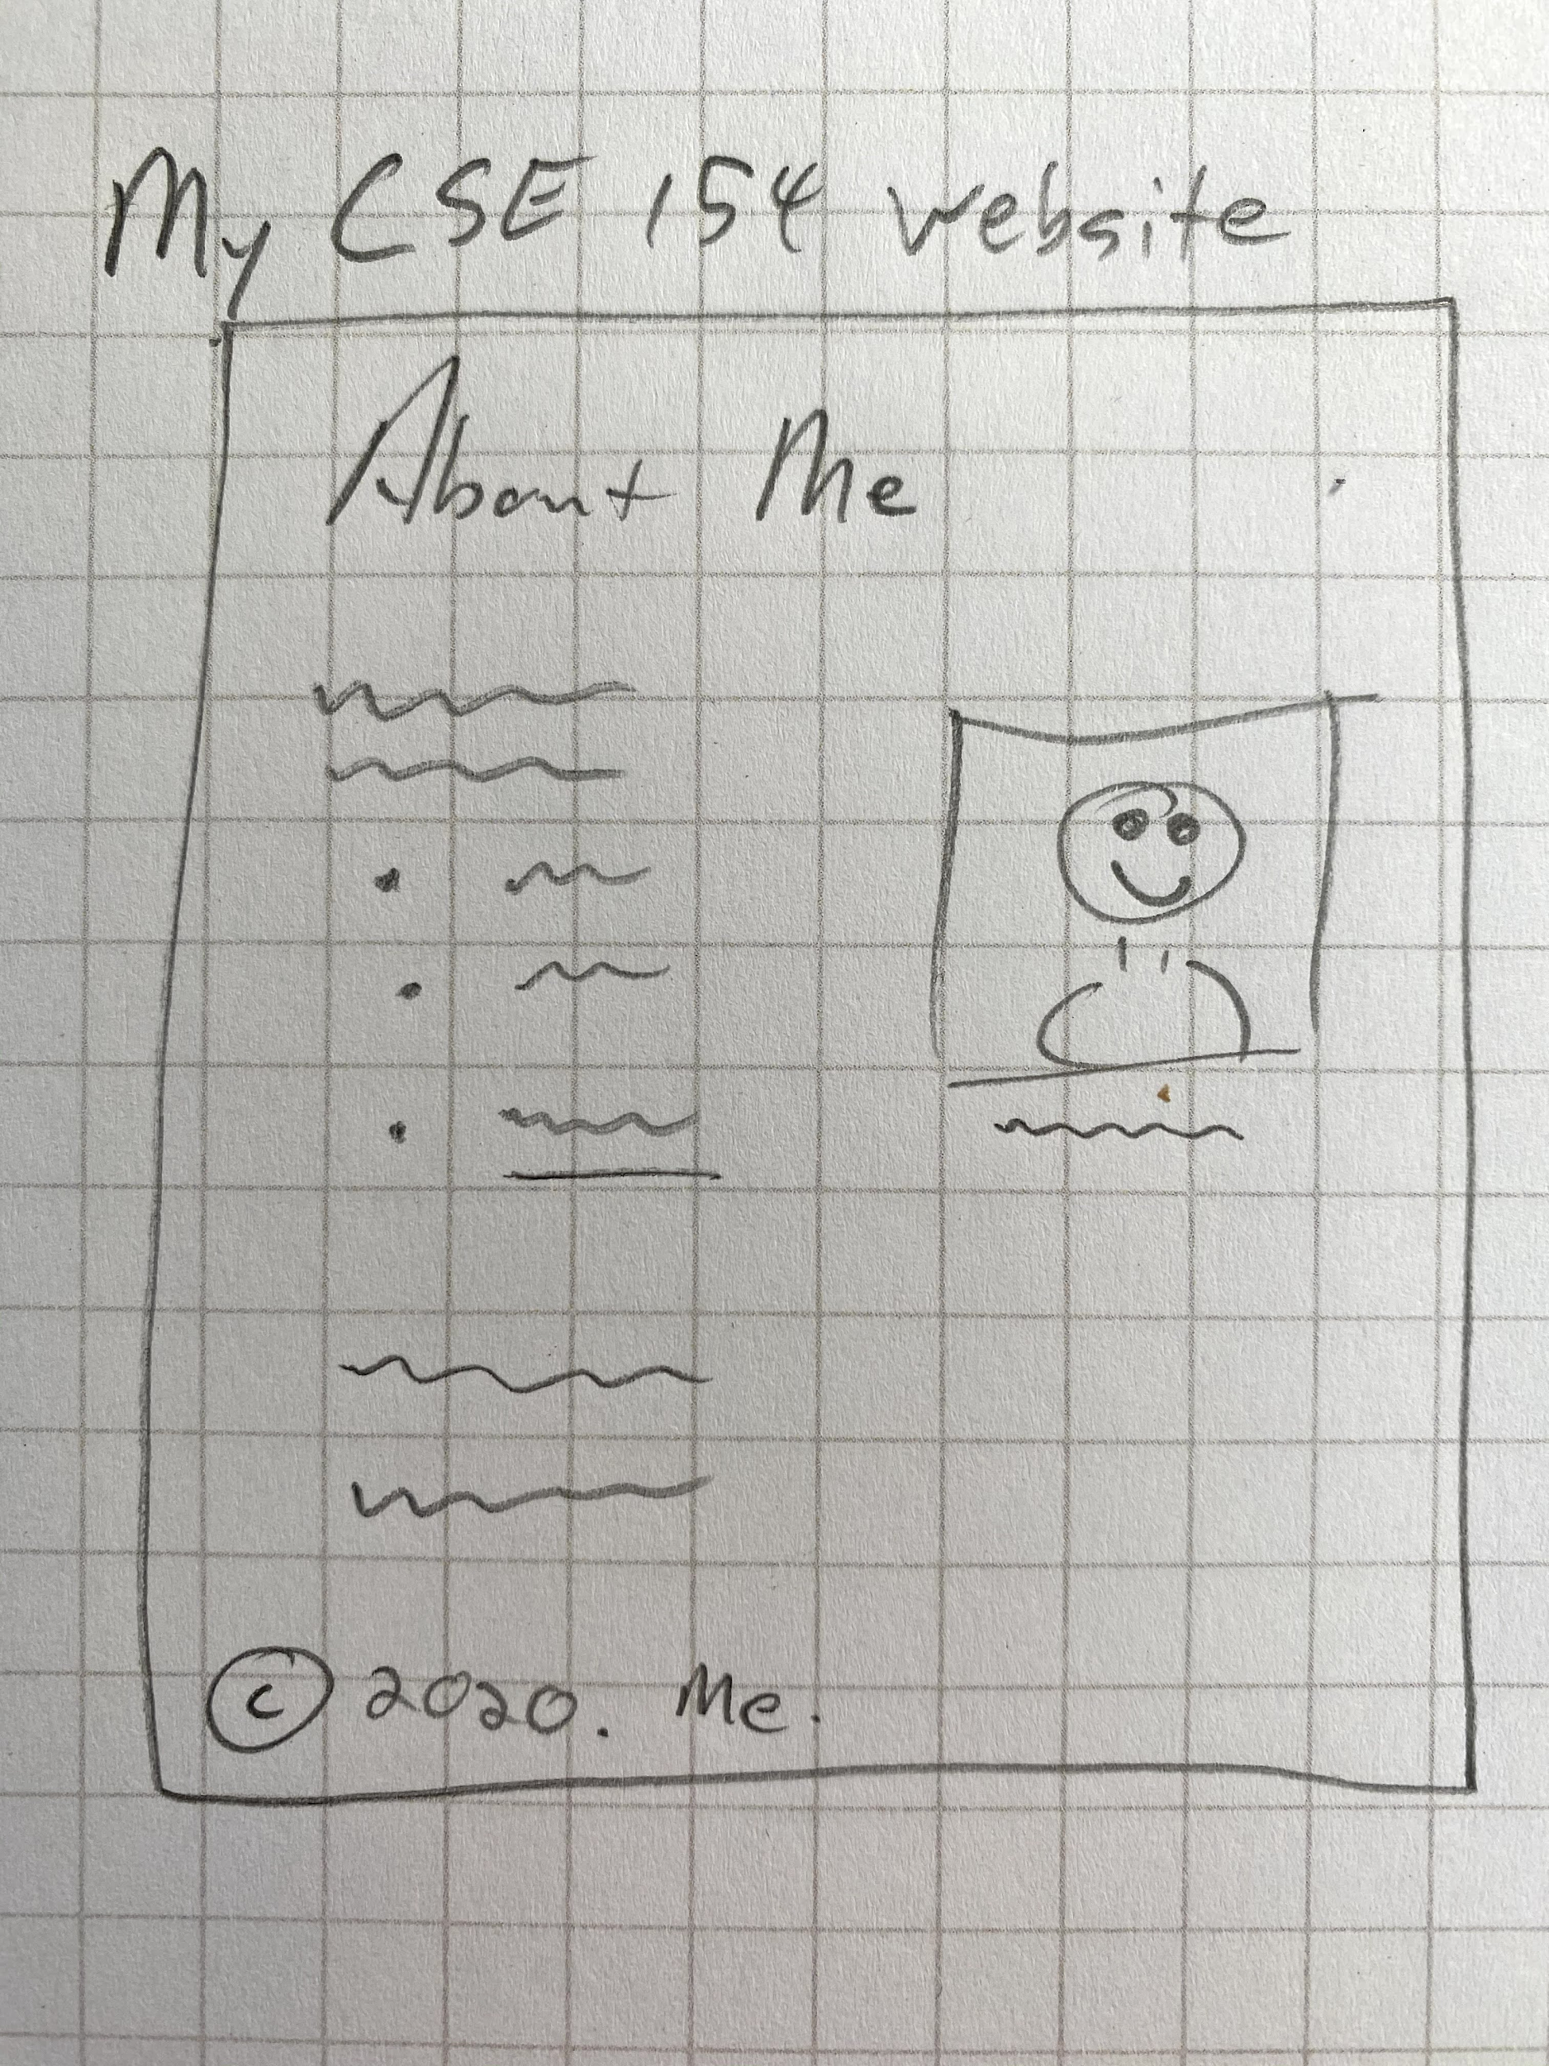
You don’t need to be an artist.

Slide 11
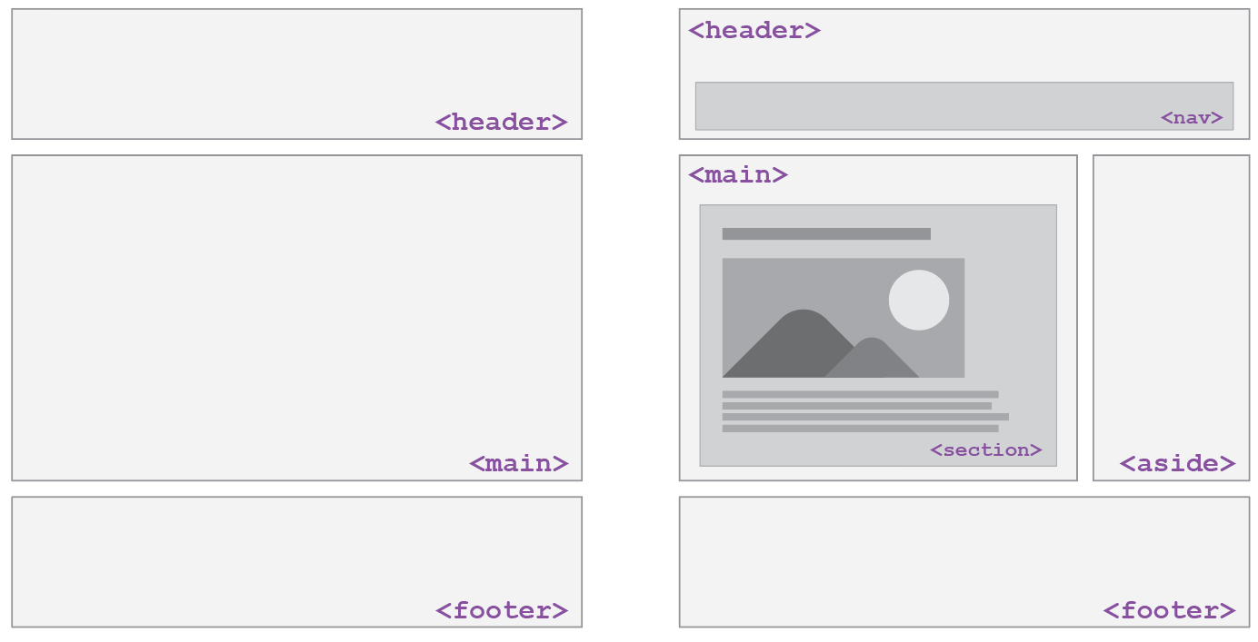
HTML5 Semantic Tags to Define Structure

Slide 12
Structure of an HTML page
An HTML page is saved into a file ending with extension .html
The <head> tag describes the page and the <body> tag contains the page's content
The DOCTYPE tag tells the browser to interpret our page's code as HTML5, the latest/greatest version of the language
<!DOCTYPE html>
<html>
<head>
information about the page
</head>
<body>
page contents
</body>
</html>

Slide 13
General Outline with HTML5
<body>
<header>
<!-- Header of the webpage body (e.g. logo, navigation bar) -->
</header>
<main>
<!-- Main section of the webpage body (where most content is) -->
</main>
<footer>
<!-- Footer of the webpage body (e.g. copyright info) -->
</footer>
</body>
For different types of pages, you may have more elements but there are the ones you should follow as a guide for most of your web pages.

Slide 14
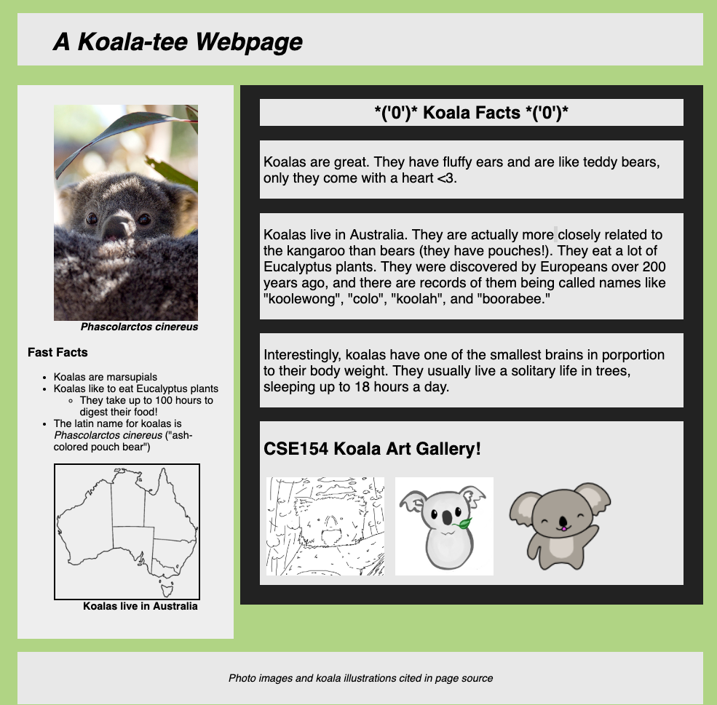
HTML vs. Rendered Web Page
<!DOCTYPE html>
<html>
<head>
<title>Koala Fan Page</title>
</head>
<body>
<header>
<h1>A Koala-tee Webpage</h1>
</header>
<main>
<aside>
<!-- Left sidebar -->
</aside>
<section>
<!-- Koala facts (header and paragraphs)-->
<article>
<!-- Koala art gallery -->
</article>
</section>
</main>
<footer>
<!-- Image citations -->
</footer>
</body>
</html>

Slide 15
HTML5 and Semantic Tags
<main>
Main content of the document - unlike <header> and <footer> tags, there can only be one main element in the <body>. The content inside should be unique and not contain content that is repeated across pages ( e.g. sidebars, nav link, search bars, etc.)
<header>
Header element - contains header information for page body or section/article, including logos, navigation bar, etc.
<footer>
Footer element - contains footer information for page body or section/article, including copyright information, contact, links, etc. Also often used with block quotes to cite sources (see CP1 about.html for an example!).

Slide 16
article vs. section
We get this question a LOT
Others ask this too
Here are two resources to help you:
Ian Devlin article (a course reading)
YouTube video
Articles are complete, standalone content. Sections are pieces of a greater whole.
And remember: div has no semantic meaning, should only be added for selecting content in CSS/JS, and should be your "last resort"

Slide 17
Some important HTML Details

Slide 18
Links (Anchors): <a>
Links, or “anchors”, to other pages (inline)
<p>
Search for it on <a href="http://www.google.com/">Google</a>!
</p>
code
Search for it on Google!
output
Uses the href (Hypertext REFerence) attribute to specify the destination URL
This can be absolute (to another web site) or relative (to another page on this site)
Anchors are inline elements; must be placed in a block element such as a <p> or <h1>

Slide 19

Images: <img>
Inserts a graphical image onto the page (inline)
<img src="img/koala-with-leaf.png" alt="A Koala with a leaf" title="Logo">
code
output
The src attribute specifies the image URL

Slide 20

Motivating alt text
HTML5 also requires an alt attribute describing the image, which improves accessibility for users who can't otherwise see it.
The value of the alt attribute is also what you see if the image is not successfully loaded.
<img src="img/koala-with-leaf-broken.png" alt="A Koala with a leaf" title="Logo">
code
output

Slide 21

More about Images
If placed in an <a> anchor tag, the image becomes a link
<a href="https://courses.cs.washington.edu/courses/cse154/20au/">
<img src="img/cse154logo.png" alt="CSE154 Course Logo" title="Logo">
</a>
code
output

Slide 22
Relative vs. Absolute Paths for Links and Images
Relative: paths are relative to the document linking to the path.
Linked files within the same directory: “filename.jpg”
<a href="my-other-page.html">Check out my other page!</a>
Linked files within a subdirectory (e.g. “img”): “img/filename.jpg”
<img src="img/koala-with-leaf.png" alt="A Koala with a leaf" title="Logo">
Absolute: paths refer to a specific location of a file, including the domain and protocol.
Typically used when pointing to a link that is published online (not within your own website).
Example: "https://validator.w3.org/"

Slide 23
Citing External Material
<figure>
<!--
Image source: Wikipedia, Made by User:Golbez
[CC BY-SA 3.0 (http://creativecommons.org/licenses/by-sa/3.0/)]
-->
<img src="https://upload.wikimedia.org/wikipedia/commons/thumb/3/3b/Australia_states_blank.png/257px-Australia_states_blank.png"
alt="Koala-land map">
<figcaption>Koalas live in Australia</figcaption>
</figure>
In your CP's, you must cite all resources that were not original (and you should give your own images credits) either on the page (as in about.html or in a footer) and/or in the page source code.

Slide 24
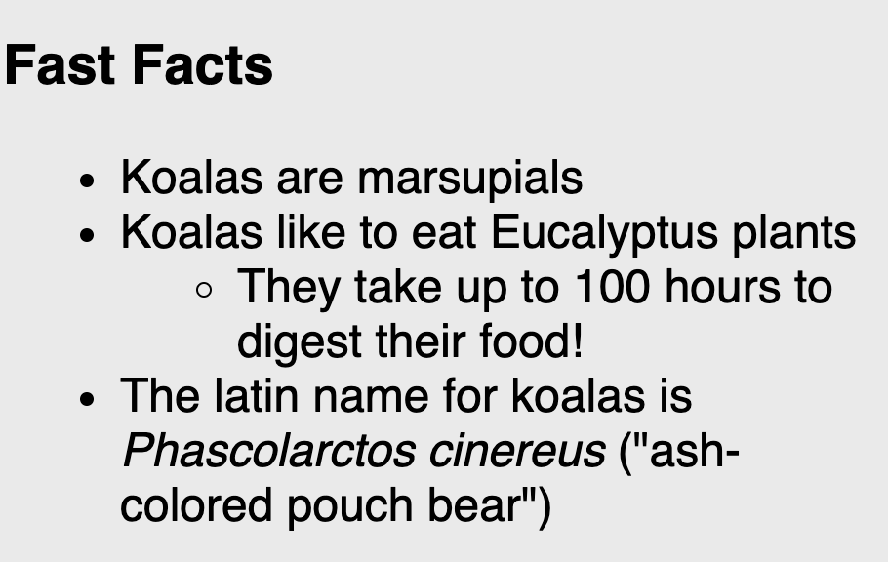
Nested Lists
A list can contain another list:
<ul>
<li>Koalas are marsupials</li>
<li>Koalas like to eat Eucalyptus plants
<ul>
<li>
They take up to 100 hours to digest their food!
</li>
</ul>
</li>
<li>
The latin name for koalas is
<em>Phascolarctos cinereus</em>
("ash-colored pouch bear")
</li>
</ul>

Slide 25
HTML Character Entities
A way of representing any Unicode character within a web page
character(s) | entity
< > | &lt; &gt;
é è ñ | &eacute; &egrave; &ntilde;
™ © | &trade; &copy;
π δ Δ | &pi; &delta; &Delta;
И | &#1048;
" & | &quot; &amp;
A complete list of HTML entities
How you you display the text &amp; on a web page?

Slide 26
Block and Inline Elements (explanation)
Block elements contain an entire large region of content
Examples: paragraphs, lists, table cells
The browser places a margin of whitespace between block elements for separation
Inline elements affect a small amount of content
Examples: bold text, code fragments, images
The browser allows many inline elements to appear on the same line
Must be nested inside a block element

Slide 27
Block and Inline Elements: example
<em>text</em>
<em>text</em>
<em>text</em>
<p>text</p>
<p>text</p>
<p>text</p>
text text text
text
text
text
code
output

Slide 28
Rules and Exceptions
Block vs. inline:
Some block elements can contain only other block elements: <body>, <form>
<p> tags can contain only inline elements and plain text
Some block elements can contain either: <div>, <li>
Some elements are only allowed to contain certain other elements
<ul> is only allowed to contain <li> (but <li> can contain <ul> for nested lists!)
Some elements are only allowed once per document:
<html>, <body>, <head>, <main>

Slide 29
Nesting Tags
Tags can “nest” inside of other tags
<body>
<p>
This is a <em>really, <strong>REALLY</strong></em> awesome paragraph.
And here's a neat list:
</p>
<ol>
<li>with one list item</li>
<li>with another list item</li>
</ol>
</body>
code
This is a really, REALLY awesome paragraph. And here's a neat list...
with one list item
and another list item!
output

Slide 30
Incorrectly Nesting Tags
<p>
HTML is <em>really,
<strong>REALLY<em class="bad"></em></em> lots of</strong> fun!
</p>
incorrect
Tags must be correctly nested
A closing tag must match the most recently opened tag
The browser may render it correctly anyway, but it is invalid HTML
How would we get the above effect in a valid way?
<p>
HTML is <em>really,
<strong>REALLY lots of</strong><em class="good"></em></em> fun!
</p>
correct

Slide 31
How can we check? Gitlab HTML Validator
Gitlab Validation Guide
Checks your HTML code to make sure it follows our official HTML syntax
More picky than the browser, which may render bad HTML correctly
NOTE: To be eligible for full credit on your creative projects and homework assignments you MUST validate all of your files and pass with no errors. Warnings are ok.

Slide 32
Web Standards
Moreover, it is important to write proper HTML code and follow proper syntax
Why use valid HTML5 and web standards?
More interoperable across different web browsers
More likely that our pages will display correctly now and in the future
To ensure accessibility

Slide 33
Accessible Design
Slides based on content from Profs. Richard Ladner, Jake Wobbrock, and Amy Ko.
This is another great resource to learn more about why/how to make websites accessible!

Slide 34
Thinking about accessibility as web developers
Who uses the web?
What are the different ways people visit and interact with websites?
Why is it important to think about users when developing websites?

Slide 35
Disabilities
Everyone has different abilities
Nearly 1 in 5 people have a disability in the U.S. (from the U.S. Census)
Some kinds of disabilities (from W3C Web Accessibility Initiative (WAI)):
Visual
Auditory
Speech
Physical
Cognitive, learning, and neurological
Behavioral

Slide 36
Temporary and Situational Disability
Disabilities can be temporary
having a broken arm in a cast
difficulty hearing after a loud concert
Disabilities can be situational
trying to open your door while carrying groceries
trying to talk on the phone in a noisy room
trying to read your phone under direct sunlight
it's raining (in Seattle?!?), and touchscreen doesn't work
Disability affects all of us

Slide 37
Accessible Design
Designs that account for all abilities are called accessible designs

Slide 38
Exercise for after lecture: Try your phone’s screen reader!
Enable your phone's screen reader
iOS: Settings > General > Accessibility > VoiceOver > Hit the switch
Android: Settings > Accessibility > Talkback > Hit the switch
Input works differently now. For example, tap now reads the screen and double-tap selects. Use two or three fingers to scroll by page. Play with it for a minute.
Try closing your eyes and reading a webpage or a social networking site. Try writing an email.

Slide 39
Views of disabilities
Medical view
People with disabilities are patients who need treatment and/or cure.
Legal view
People with disabilities have rights and responsibilities, such as access to public buildings, voting, education, etc.
Lawsuits can occur, but they should not be the motivating factor for making a system accessible
Sociocultural view
Variation in ability is natural. "Disability" is caused by how society is designed, not by nature.
Building for inclusion builds innovation (e.g., curb cuts, closed captioning)

Slide 40
Tools and Resources
From the A11y Project
A really great compendium of resources
An accessibility workshop from GHC'18
Tools
Web Accessability Evaluation Tool: http://wave.webaim.org/
Color Schemes: http://colorbrewer2.org/
Color blindness checker: http://www.color-blindness.com/coblis-color-blindness-simulator/
Text readability: http://juicystudio.com/services/readability.php
Resources
Web Content Accessibility Guidelines (something to know about when you apply for jobs): https://www.w3.org/WAI/intro/wcag
Teach Access Tutorial (general background and covers an important standard called ARIA). http://teachaccess.org/initiatives/tutorial/
Web design and development course by AccessComputing http://www.washington.edu/accesscomputing/webd2/
A11ycast - YouTube Videos to teach developers how accessibility works.

Slide 41
Accessible Web Design Principles
Use document structure (Semantic) tags: e.g., <article>, <strong>
Don't use deprecated style tags like <b>
Provide metadata: e.g., <html lang="en">
Provide alternatives: e.g., img alt tag, video captions, transcripts, allow both keyboard and mouse input
Avoid directional text: eg. "the diagram on the right shows..."
Note: These design principles help in other ways as well
Captions allow people to watch your video without turning sound on.
Transcripts help people find your page through Google.
Structure and metadata help programs understand your page.
More about HTML and accessibility here.

Slide 42
Preview to CSS

Slide 43
The Bad Way to Produce Styles
<p>
<font face="Arial">Welcome to Greasy Joe's.</font>
You will <b>never</b>, <i>ever</i>, <u>EVER</u> beat
<font size="+4" color="red">OUR</font> prices!
</p>
code
Welcome to Greasy Joe's. You will never, ever, EVER beat OUR prices!
output
Tags such as b, i, u and font are discouraged in strict HTML
They are bad because of:
Accessibility
Code organization
Changing style easily

Slide 44
Cascading Style Sheets (CSS): <link>
<head>
...
<link href="filename" rel="stylesheet">
...
</head>
CSS describes the appearance and layout of information on a web page (as opposed to HTML, which describes the content)
Can be embedded in HTML or placed into separate .css file (preferred)

Slide 45
Basic CSS Rule Syntax
selector {
property: value;
property: value;
...
property: value;
}
template
p {
color: red;
font-family: sans-serif;
}
example
A CSS file consists of one or more rules
A rule selector specifies HTML element(s) and applies style properties

